Slide 1
Steelhead Annual Loss Prediction
Chase and Brian

Slide 2
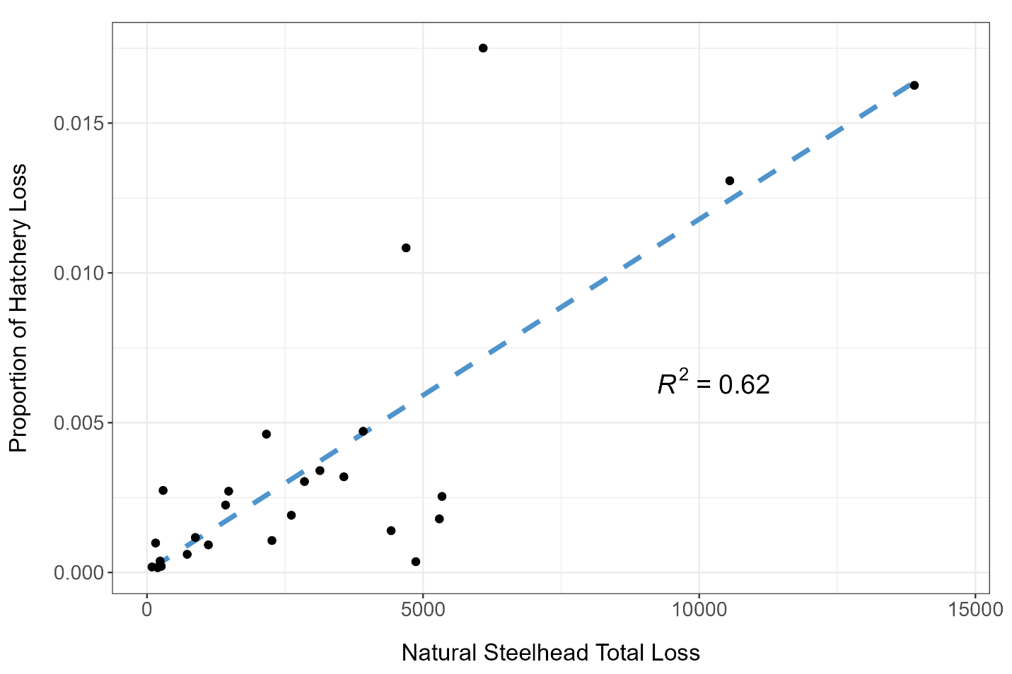
Hatchery Loss v Natural Loss

Slide 3
Predict with water year types?
Past water year types would partially determine future steelhead life history strategies
Early life history survival
Growth
Density-dependence
Etc.
Majority of outmigrants are age 2 smolts
We looked at previous 2 years water types as they relate to current year salvage
Just the San Joaquin Index
Salvage Year | WY type - 1 | Wytpe - 2
2024 | 2023 | 2022
2023 | 2022 | 2021
2022 | 2021 | 2020
2021 | 2020 | 2019

Slide 4
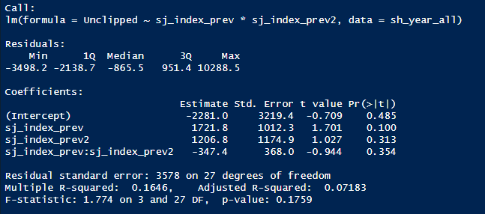
Using all years of salvage (1995-2024)
Simple linear regression to start off with.
Fit for all years of salvage was poor.
No significance in the covariates or intercept
R-squared was low

Slide 5
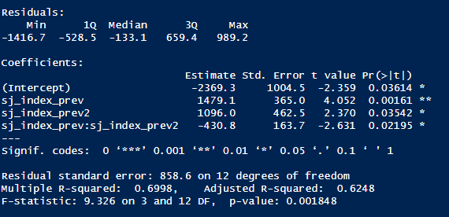
Post 2008 BiOP years (2009-2024)
Simple linear regression
Fit was much better
Significance in the intercept and covariates
Much better R squared value

Slide 6
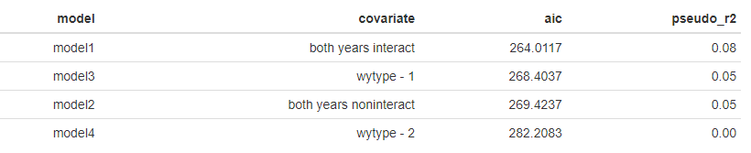
Slighty more robust model
General linearized model with a log function
Looked at Water Year type - 1 and Water Year type – 2 separately, with interaction and without interaction.
sj_index_prev
sj_index_prev2
sj_index_prev * sj_index_prev2
sj_index_prev + sj_index_prev2

Slide 7
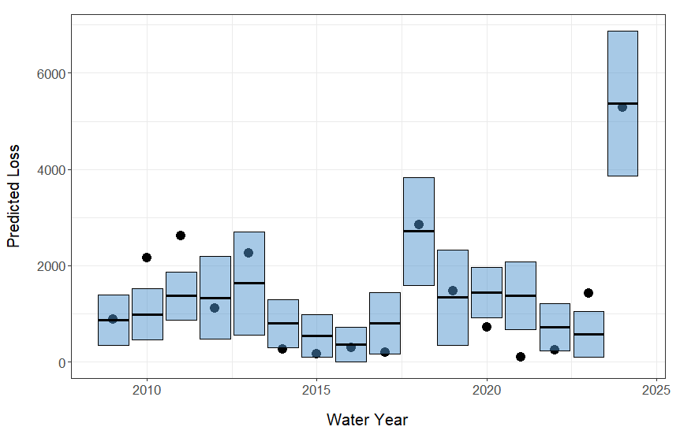
How well does it predict?
Current WY 2025 Loss = 587
Predicted WY 2025 Loss = 1029

Slide 8
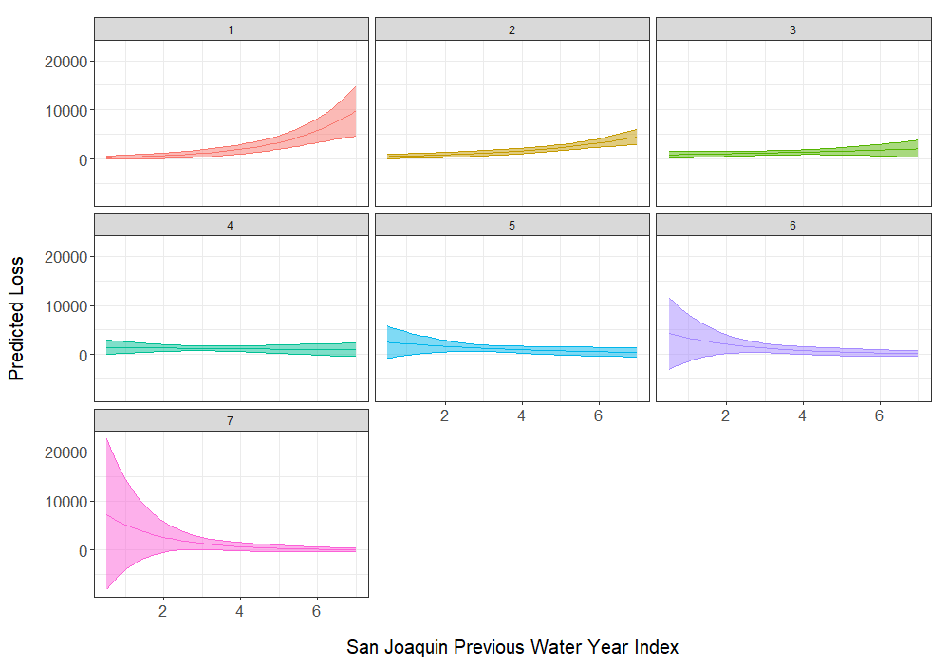
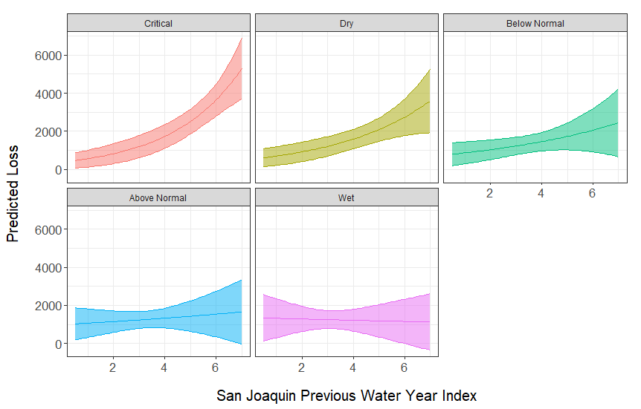
Continuous Model

Slide 9
Next steps and discussion
Playing around with other covariates (OMRI, Exports, Vernalis flow, etc)
More robust analysis
Cross validation, variance inflation factor, etc.

